Slide 1
Memory Dump Analysis

Slide 2
Intro to Memory Dump Analysis
Memory dumps capture the state of volatile memory at a given instant; can provide information into network connections, credentials, application data, encryption keys, and other critical data that are loaded into memory when a process runs
Memory dumps can be created by dumping a computer’s RAM or by dumping the state and heap of individual processes

Slide 3
Memory Imaging
Memory dumps can be obtained by using memory imaging tools like the following:
FTK Imager
procdump
dd
FireEye RedLine
Magnet RAM Capture
Process Explorer
jmap

Slide 4
Memory Forensics
Commonly used tools/commands:
strings
Volatility
Mimikatz
FTK Imager
FireEye RedLine
AutoTimeLiner

Slide 5
Volatility
Open-source tool for analyzing memory dumps
Does not support the acquisition of memory samples
Use tools like FTK Imager (x86 32bit and 64 bit), LiME (Linux), Goldfish (OS X) for system memory

Slide 6
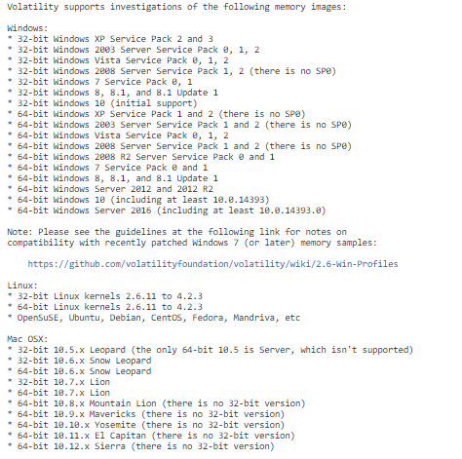

Slide 7
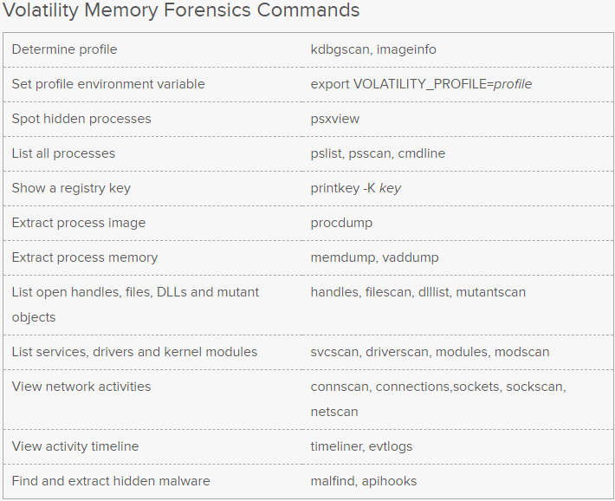

Slide 8
Identifying OS Profiles
One of the first steps in analyzing an unfamiliar raw image is to identify the OS profile
The imageinfo plugin can be used with volatility to try to identify the operating system, service pack, and hardware architecture
Will provide best profile suggestion
The profile can be specified with the parameter –profile=PROFILE
Tries to identify the KDBG (_KDDEBUGGER_DATA64) structure that can be used with pslist to find process and module list heads
The kdbgscan plugin specifically tries to identify the correct profile and KDBG address (useful if there is more than one)
Notes:
KDBG structure is used by kernel debugger to find out state of the OS, includes memory addresses of a large number of kernel variables in Windows

Slide 9
Identifying Processes
Using the pslist plugin, processes in a system memory dump can be enumerated by identifying _PsActiveProcessHead of the _EPROCESS list and walks through the list of processes
The pscan plugin searches the entire memory dump for process structures, rather than using the _EPROCESS list
More reliable as the _EPROCESS list can be modified and process structures removed using direct kernel object manipulation (DKOM)

Slide 10
Dumping Process-Specific Memory
volatility vaddump -p <pid of desired process> -f <your memorydump.mem> --dump-dir=<your dump dir>

Slide 11
Playing with the Registry
hivescan plugin can be used to enumerate physical address offsets of registry hives in memory
hivelist plugin locates the virtual addresses and full paths of registry hives
printkey plugin takes a key argument and displays the subkeys, values, data, and data types associated with it

Slide 12
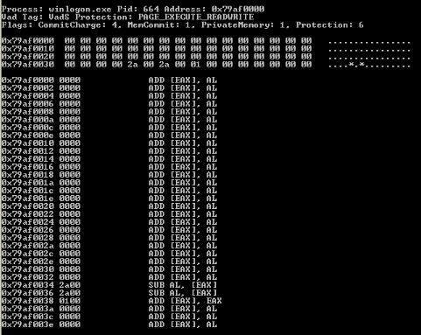
Identifying Shellcode
Using the volatility plugin malfind, sections of a memory dump that are executable but aren’t associated with mapped files (PAGE-EXECUTE_READWRITE VAD Tags are identified) This can sometimes be indicative of embedded shellcode.

Slide 13
Other Useful Plug-Ins
vadinfo
svcscan
dlllist
ldrmodules
impscan

Slide 14
Memory Forensics for CTFs
CTF challenges involving memory dumps require analyzing an unknown memory dump for a specific piece of information, e.g. a password, an event, a specific registry key, etc.
The OS version should be identified first using kdbgscan, imageinfo, or using manual methods, before further analysis is done with volatility

Slide 15
Additional Resources
Volatility Resources
https://www.andreafortuna.org/cybersecurity/volatility-my-own-cheatsheet-part-1-image-identification/
Dumps:
https://www.forensicfocus.com/images-and-challenges

